Slide 1

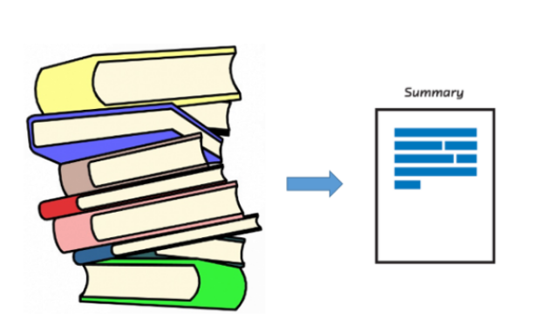
Abstractive Text Summarization
By
Manu Mahadevaswamy -10524425
Guided by
Abhishek Kaushik, Lecturer and PhD Researcher
(Professor at Dublin Business School)

Slide 2
Table of contents
What is Text Summarization?
Motivation and Problem Statement
Methodology – PEGASUS
Fine - tuning PEGASUS
Results
Limitations and Future scope

Slide 3
What is Text Summarization?
Text summarization is the application of Natural Language Processing (NLP), aimed at producing a short and fluent summary while retaining key information and overall meaning
There are two types of text summarization: Extractive summarization and Abstractive summarization
Applications
Summaries of email chains
Minutes of meeting
Summaries of newsletter
Summaries of books and literatures

Slide 4
Motivation and Problem Statement
To implement self-supervised abstractive text summarization model that generates concise and accurate summaries from input text-documents on fine-tuning with low-resource downstream summarization datasets.
Research Question
How does a pre-trained objective tailored to suit the abstractive text summarization generalize across datasets?
Related work
Existing pre-trained multi-purpose language models based on transfer-learning.
Examples: BERT, T5 (Text-to-Text Transformer), GPT

Slide 5
Methodology – PEGASUS
Pre-training objective
A self-supervised pre-training objective, Gap-Sentences Generation (GSG), which closely resembles the objective functions of downstream text summarization applications outperform existing sequence models.
P
E
G
A
S
U
S
GSG & MLM
Transformer

Slide 6
Fine-tuning PEGASUS
PEGASUS
(Weights)
TEXT SUMMARIZATION
MODEL
PEGASUS model needs to be further fine-tuned (trained) with the downstream labelled datasets – data from the actual application.
It produces state-of-the-art results with as few as 1000 examples. And the accuracy improves as we increase the number of examples.
Train PEGASUS with Text and corresponding Summaries
Labelled data
( X, y )
( Text, Summary)

Slide 7
Results – WikiHow data
Abstractive Text Summarization Results:
Abstractive Text Summarization Results:

Slide 8
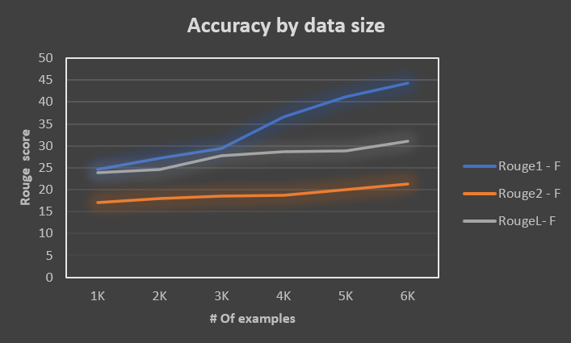
Results – WikiHow data
Abstractive Text Summarization Results
The machine generated summary matches the
Gold or the reference summary as we increase
the number of examples in the fine-tuning data.
Abstractive Text Summarization Results:

Slide 9
Results – Amazon review data
Though the actual summary and the summary generated by our model do not match in terms of words, both are conveying the same meaning
Abstractive Text Summarization Results:

Slide 10
Limitations and Future scope
Limitations
Abstractive text summarization results can be further optimized by pre-training on more diverse text corpus. This model is complex in terms of the computational resource usage and is limited to single document text summarization.
Future scope
The Abstractive Summarization model based on PEGASUS can be used to summarize the long pdf notes, online articles, IT tickets, machine generated error texts, etc.

